Slide 1
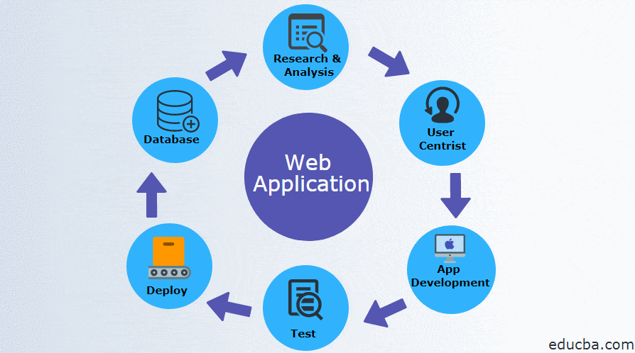
WEB APPLICATION

Slide 2
Requirement gathering and analysis
Business Analyst (BA) will try to get the requirement from the client and understands it and prepare a
document called Business Requirement Document (BRD)
Design
Design team will prepare a document called Design Specification Document, which will give details
about how the front and back end could interact. E.g., Workflow/ Sample image

Slide 3
Development: (Dev Environment)
Developers will develop the software by using any coding language and they will do a test called Unit
Testing to check whether the code is working fine or not.
Testing: (Testing Environment)
Once developer completes the Unit Testing then they will move their code or build into testing
environment and tester will test the applications as per the flow- STLC (Testing life cycle)

Slide 4
Deployment: (Live Environment)
• Once a program has passed the testing phase, it is ready for deployment.
i.e., Deploy the application in the live environment.
• Typically, it happens at Non-Peak Hours (During low usage of internet)
Operation and Maintenance:
• Maintenance of software can include software upgrades, repairs, and fixes of the software if it breaks

Slide 5
USE TEST CASE FOR ORANGEHRM
TC#ID | Project/ModuleName | Req#ID | Scenario | Test Case Title | Steps | Test Data | Expected Results | Actual Result | Status (Passed/Failed)
Tc_001 | LoginPage | 3.1 | Check the loginPage is working properly or not | Verify Login with valid username and password | 1) Launch browser 2) Open URL "https://opensource-demo.orangehrmlive.com/web/index.php/auth/login" 3) Provide vaild username 4) Provide vaild password | Admin/admin123 | Login succful. User should see Myinfo page after login is succfull. | Login Succfull | Passed
Tc_002 | LoginPage | 3.1 | Check the loginPage is working properly or not | Verify Login with invalid username and valid password | 1) Launch browser 2) Open URL "https://opensource-demo.orangehrmlive.com/web/index.php/auth/login" 3) Provide Invaild username 4) Provide vaild password | User/admin123 | Login succful. User should see Myinfo page after login is succfull. | Login Failed | Failed

Slide 6
TC#ID | Project/ModuleName | Req#ID | Scenario | Test Case Title | Steps | Test Data | Expected Results | Actual Result | Status (Passed/Failed)
Tc_003 | LoginPage | 3.1 | Check the loginPage is working properly or not | Verify Login with invalid username and valid password | 1) Launch browser 2) Open URL "https://opensource-demo.orangehrmlive.com/web/index.php/auth/login" 3) Provide Invaild username 4) Provide vaild password | User@132/admin123 | Login succful. User should see Myinfo page after login is succfull. | Login Failed | Failed
Tc_004 | LoginPage | 3.1 | Check the loginPage is working properly or not | Verify Login with invalid username and valid password | 1) Launch browser 2) Open URL "https://opensource-demo.orangehrmlive.com/web/index.php/auth/login" 3) Provide Invaild username 4) Provide vaild password | 123_ad/admin123 | Login succful. User should see Myinfo page after login is succfull. | Login Failed | Failed
Tc_005 | LoginPage | 3.1 | Check the loginPage is working properly or not | Verify Login with invalid username and invalid password | 1) Launch browser 2) Open URL "https://opensource-demo.orangehrmlive.com/web/index.php/auth/login" 3) Provide Invaild username 4) Provide Invaild password | 123_ad/admin | Login succful. User should see Myinfo page after login is succfull. | Login Failed | Failed

Slide 7
TC#ID | Project/ModuleName | Req#ID | Scenario | Test Case Title | Steps | Test Data | Expected Results | Actual Result | Status (Passed/Failed)
Tc_006 | LoginPage | 3.1 | Check the loginPage is working properly or not | Verify Login with valid username and invalid password | 1) Launch browser 2) Open URL "https://opensource-demo.orangehrmlive.com/web/index.php/auth/login" 3) Provide vaild username 4) Provide Invaild password | Admin/admin@132 | Login succful. User should see Myinfo page after login is succfull. | Login Failed | Failed
Tc_007 | LoginPage | 3.1 | Check the loginPage is working properly or not | Verify Login with valid username and invalid password | 1) Launch browser 2) Open URL "https://opensource-demo.orangehrmlive.com/web/index.php/auth/login" 3) Provide vaild username 4) Provide Invaild password | Admin/AdMin12345 | Login succful. User should see Myinfo page after login is succfull. | Login Failed | Failed
Tc_008 | LoginPage | 3.1 | Check the loginPage is working properly or not | Verify Login with valid username and invalid password | 1) Launch browser 2) Open URL "https://opensource-demo.orangehrmlive.com/web/index.php/auth/login" 3) Provide vaild username 4) Provide Invaild password | Admin/123456098754 | Login succful. User should see Myinfo page after login is succfull. | Login Failed | Failed

Slide 8
TC#ID | Project/ModuleName | Req#ID | Scenario | Test Case Title | Steps | Test Data | Expected Results | Actual Result | Status (Passed/Failed)
Tc_009 | LoginPage | 3.1 | Check the loginPage is working properly or not | Verify Login with valid username and invalid password | 1) Launch browser 2) Open URL "https://opensource-demo.orangehrmlive.com/web/index.php/auth/login" 3) Provide vaild username 4) Provide Invaild password | Admin/12345%^98754 | Login succful. User should see Myinfo page after login is succfull. | Login Failed | Failed
Tc_010 | LoginPage | 3.1 | Check the loginPage is working properly or not | Verify Login with valid username and invalid password | 1) Launch browser 2) Open URL "https://opensource-demo.orangehrmlive.com/web/index.php/auth/login" 3) Provide vaild username 4) Provide Invaild password | Admin/ASDFG | Login succful. User should see Myinfo page after login is succfull. | Login Failed | Failed
Tc_011 | Leave page | 3.2 | Check the my leave has applied properly or not | Verify Application of leave is succfully | 1) homepage is lanuched 2) Select the leave option 3) Now select the apply button 4) Select the level Type 5) Enter the from and to date 6) Enter the comment 7) And click the apply button |  | Succfully applied the leave User should check the application is reflected in my leave or not
Tc_012 | My Info page | 3.3 | user can view Personal details | Verify user is able to view Personal Details | 1) Login to OrangeHRM as user 2) Click on MyInfo tab 3) Click on Personal Details link | NA | User should able to view Personal Details

Slide 9
TC#ID | Project/ModuleName | Req#ID | Scenario | Test Case Title | Steps | Test Data | Expected Results | Actual Result | Status (Passed/Failed)
Tc_013 | My Info page | 3.3 | user can edit Personal details | Verify user can edit some fileds in Personal Details | 1) Login to OrangeHRM as user 2) Click on MyInfo tab 3) Click on Personal Details link 4) Click on Edit button 5) Edit FullName /Middle Name, Last Name,License Expiry Date, Gender, Marital Status and Nationality. | NA | User should able to edit and save details.
Tc_014 | My Info page | 3.3 | user cannot edit restricted fileds in Personal details | Verify user cannot edit restricted fields | 1) Login to OrangeHRM as user 2) Click on MyInfo tab 3) Click on Personal Details link 4) Click on Edit button | NA | The following fields should be non-editable. Employee ID SSN No SIN No Driver License No Date of Birth
Tc_015 | My Info page | 3.3 | user can add a photograph | Verify user is able to add photograph | 1) Login to OrangeHRM as user 2) Click on MyInfo tab 3) Click on the photograph at corner of the screen 4) Click "Browse" and then select a photograph from the relevant path 5) Click "Upload" once you have selected the picture | Images

Slide 10
Tc_016 | My Info page | 3.3 | user can view Contact Details | Verify user is able to view Contact Details | 1) Login to OrangeHRM as user 2) Click on MyInfo tab 3) Click on Contact Details link | NA | User should able to view Contact details
Tc_017 | My Info page | 3.3 | user can edit Contact Details | Verify user can edit some fileds in Contact Detials | 1) Login to OrangeHRM as user 2) Click on MyInfo tab 3) Click on Contact Details link 4) Click on Edit button 5) Edit fields Addr Streat1,Addr Streat2,City,State,Zip,Country,Telephone,Mobile, Work Telephone,Work Email and Other Email 6) Click on Save button | NA | User should able to edit and save contact details.
Tc_018 | My Info page | 3.3 | user can add Emergency Contact | Verify user able to add Emergency contact | 1) Login to OrangeHRM as user 2) Click on MyInfo tab 3) Click on Emergency Contacts link 4) Click on Add button 5) Provide Emergency contact details Name (Mandatory field) Relationship (Mandatory field) Home Telephone Mobile Work Telephone 6) Click on Save button | NA | Succfully saved Details should be appeared under Emergency Contacts table.
TC#ID | Project/ModuleName | Req#ID | Scenario | Test Case Title | Steps | Test Data | Expected Results | Actual Result | Status (Passed/Failed)

Slide 11
TC#ID | Project/ModuleName | Req#ID | Scenario | Test Case Title | Steps | Test Data | Expected Results | Actual Result | Status (Passed/Failed)
Tc_019 | My Info page | 3.3 | user can add multiple Emergency Contact | Verify user able to add multiple Emergency contacts | Repeat steps from TC_MyInfo_011 | NA | Succfully saved Multiple Emergency Contact Details should be appeared under Emergency Contacts table.
Tc_020 | My Info page | 3.3 | user can delete Emergency Contacts | Veryfy user able to delete Emergency contacts | 1) Login to OrangeHRM as user 2) Click on MyInfo tab 3) Click on Emergency Contacts link 4) Click on the check box next to particular entry 5) Click on Delete button | NA | Succfully Deleted Entries should disappear from Emergency Contacts table.
Tc_021 | My Info page | 3.3 | user can add Dependant | Verify user able to add dependant | 1) Login to OrangeHRM as user 2) Click on MyInfo tab 3) Click on Depandants link 4) Click on Add button under Assigned Dependents 5) Provide details Name (mandatory field) Relationship(select from drop down) Date of Birth 6) Click on Save button | NA | Succfully saved Depandant Details should be appeared under Assigned Dependants table.

Slide 12
TC#ID | Project/ModuleName | Req#ID | Scenario | Test Case Title | Steps | Test Data | Expected Results | Actual Result | Status (Passed/Failed)
Tc_022 | My Info page | 3.3 | user can add multiple Dependants | Verify user able to add multiple Dependants | Repeat steps from TC_MyInfo_014 | NA | Succfully saved Multiple Dependants Details should be appeared under Assigned Dependents table.
Tc_023 | My Info page | 3.3 | user can delete Dependants | Verify user able to delete Dependants | 1) Login to OrangeHRM as user 2) Click on MyInfo tab 3) Click on Dependants link 4) Click on the check box next to particular entry 5) Click on Delete button | NA | Succfully Deleted Entries should disappear from Assigned Dependents table.

Slide 13
DEFECT LIFE CYCLE
New:
When the defect is found and posted for the first time.
Assigned:
Once the defect is posted, the testing team lead will assign it to Developing Team.
Open:
Once the developer opens the bug and works on to fix it.
Fixed:
When developer fix the bug with appropriate codes.
Pending Retest:
Once the developer fixes the bug, it will be moved to testing team

Slide 14
Retest: Tester does the retesting of the code at this stage to check whether the defect is fixed by the developer or not
Verified:
If the tester confirms that the bug is fixed.
Reopen:
If the tester confirms that the bug is not yet fixed and found the same defect. Again, it will be
moved to Assigned Stage and the flow continuous.
Closed:
Once the tester verified that the bug is fixed, then the defect raised will be closed.
Duplicate:
If the bug is already raised by someone, and if it is raised again means it is duplicate.
Rejected/Not a Bug:
When the developer feels that the bug is not genuine.
Deferred/Not Important:
The bug which developer feels that it can be fixed later on the upcoming sprints.

